Slide 1

YouTube Summary and Feedback System
BY:
Ayush Bhusal
Chimezie Anthony
Nabin Bamma

Slide 2
Product Backlog
Sprint 1: Green Color Coded
Sprint 2: Purple Color Coded
Sprint 3: Orange Color Coded

Slide 3



ID | Product Backlog | Estimation
1 | As a User, I can enter a YouTube video URL on the home page and click “Search” to initiate video data retrieval (metadata including title, description and duration), transcript, and comments). | 3
2 | The Web Server can validate the YouTube URL format and extract the video ID. | 2
3 | The Web Server can retrieve video metadata (e.g., title, description, duration) from the YouTube API using the video ID. | 3
4 | The Web Server can retrieve the video transcript from the YouTube API using the video ID. | 3
5 | The Web Server can retrieve at least 100 video comments from the YouTube API using the video ID. | 2
6 | The Web Server will enforce operational constraints by excluding videos longer than 1 hour and ensuring at least 100 comments are available; if not, it notifies the User. | 2
7 | The Web Server can remove timestamps from the retrieved transcript. | 1
8 | The Web Server can remove filler words from the retrieved transcript. | 1
9 | The Web Server can remove spam content from the retrieved transcript. | 2
10 | The Web Server can remove off‐topic remarks from the retrieved transcript. | 2
11 | The Web Server can remove unrelated discussions from the retrieved transcript. | 2

Slide 4
ID | Product Backlog | Estimation
12 | The Web Server can process the cleaned transcript for further analysis. | 1
13 | The Web Server can store the processed transcript data. | 1
14 | The Web Server can send the clean transcript to the AI API to generate a concise video summary in paragraph form and save it. | 5
15 | VADER sentiment analysis library from Python can define and implement the interface. | 2
16 | The Web Server will use VADER from Python library to classify filtered comments as positive, negative, or neutral, and store the sentiment analysis results. | 3
17 | The AI API can define and implement the interface for processing filtered comments. | 1
18 | The AI API can extract actionable “What’s Working” feedback from filtered comments. | 1
19 | The AI API can extract actionable “Needs Improvement” feedback from filtered comments. | 1
20 | The Web Server can generate a structured feedback report categorizing “What’s Working” and “Needs Improvement” and store the report. | 2
22 | As a User, I can view a results page that displays the generated video summary. | 3
23 | As a User, I can view a results page that displays detailed sentiment analysis results of comments. | 1
24 | As a User, I can view a results page that displays the structured feedback report categorizing “What’s Working” and “Needs Improvement”. | 1

Slide 5
Previous: Sprint 2 implementation
Transcript summarization completed
01
Sentiment analysis integrated
02
Feedback extraction implemented
03
Basic UI added for displaying results
04

Slide 6
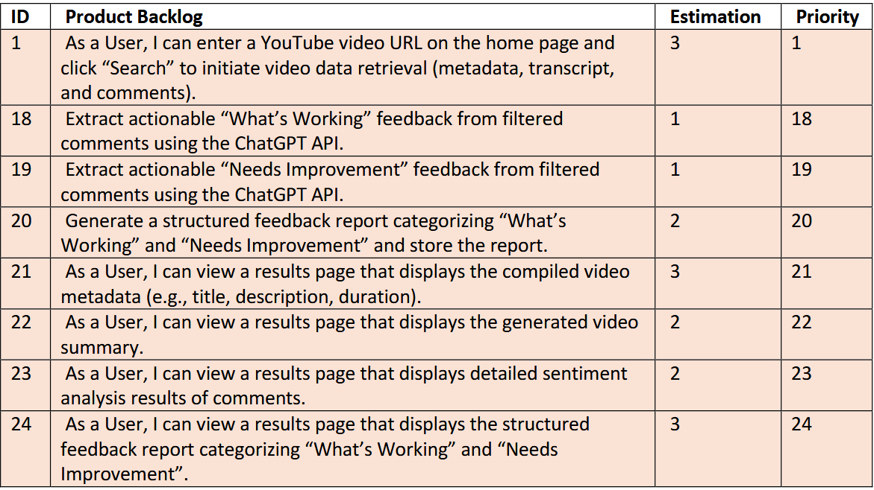
Sprint 3: Implementation
Integrated Tkinter UI with HomePage (ID 1) for input and ResultsPage to display analysis (ID 21, 22, 23, 24)
Applied prompt engineering to improve structure and clarity of AI-generated outputs (ID 18, 19)
Auto-displayed video summary, sentiment %, and bullet-point feedback in scrollable UI
Implemented background threading with loading popup for smooth UX
Saved feedback as timestamped .txt report in /reports folder (ID 20)

Slide 7

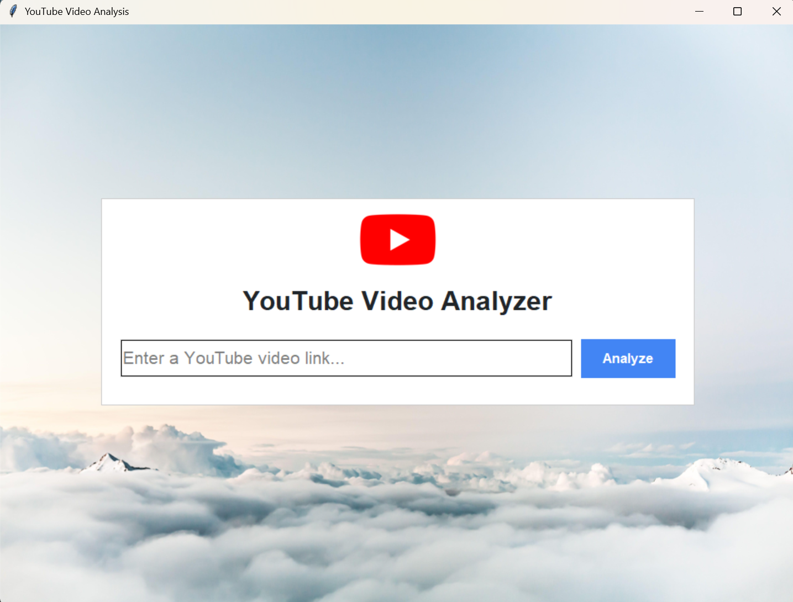

Demo SS: Home page

Slide 8
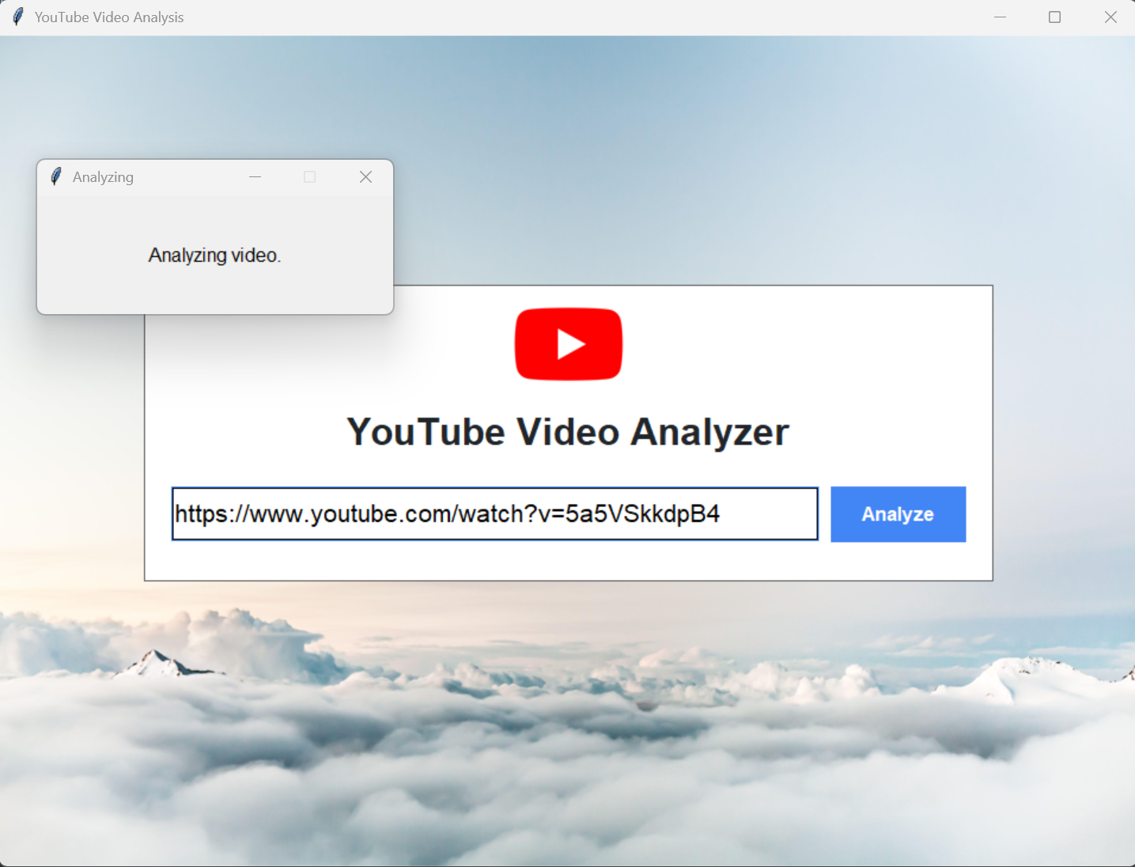
Demo SS: Home page when analyzing

Slide 9
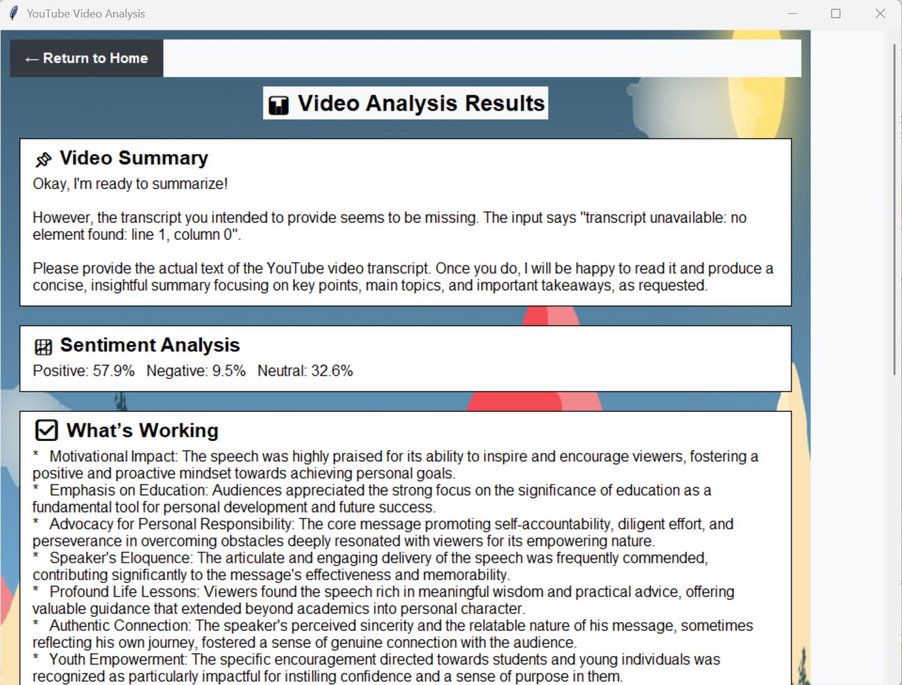
Demo SS: Results Page Pt1

Slide 10
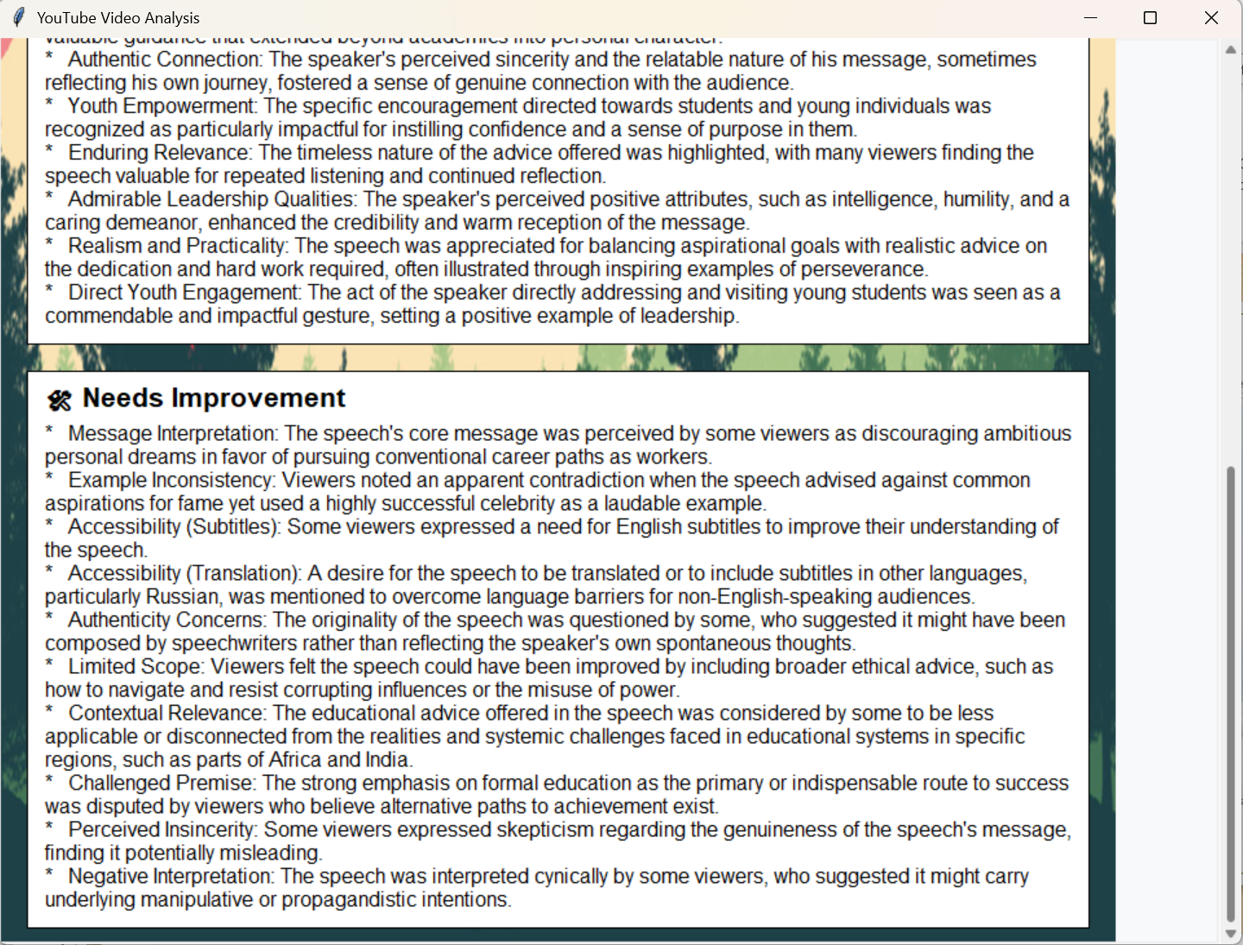
Demo SS: Results Page Pt2

Slide 11
Test Cases

Slide 12
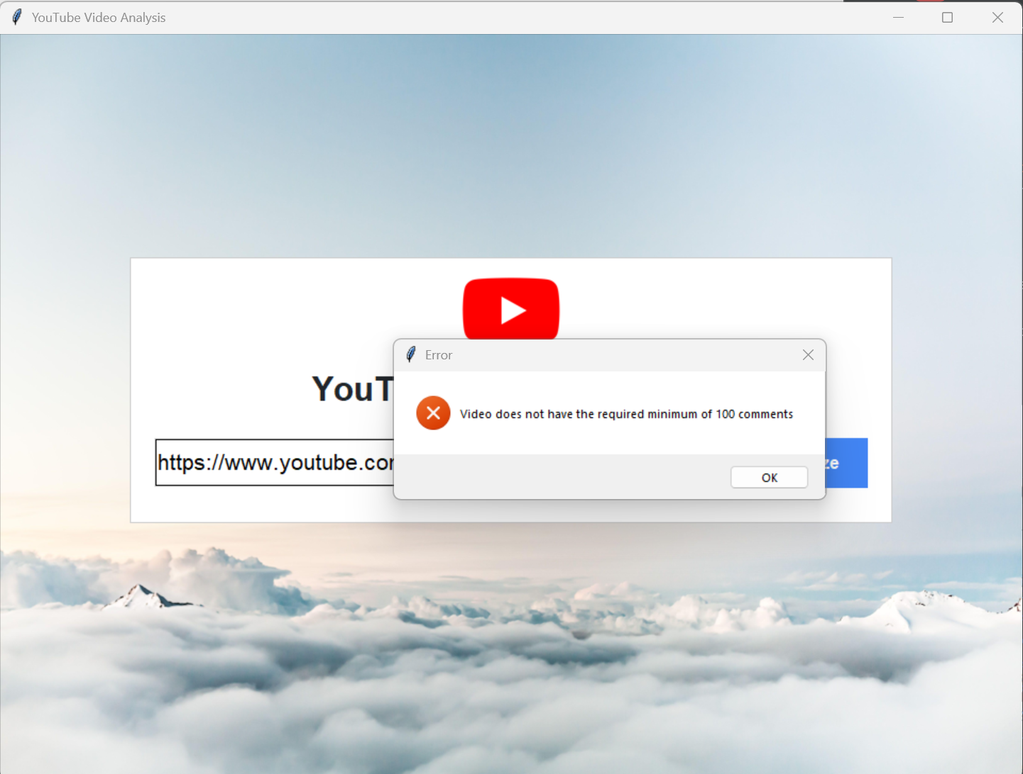
Test Case 1: If comment less than 100

Slide 13
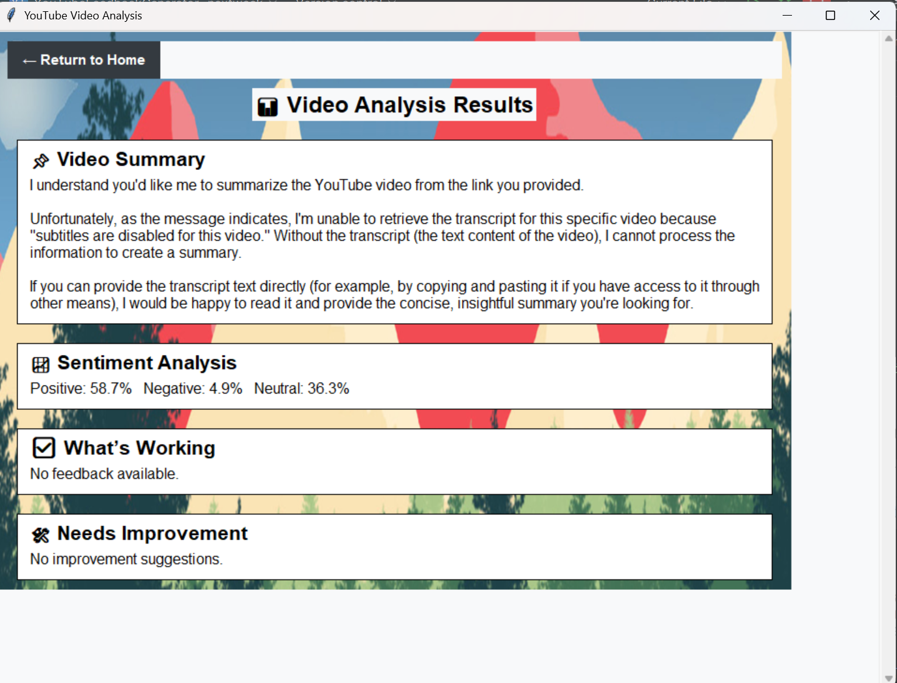
Test Case 2: When there is no transcript

Slide 14
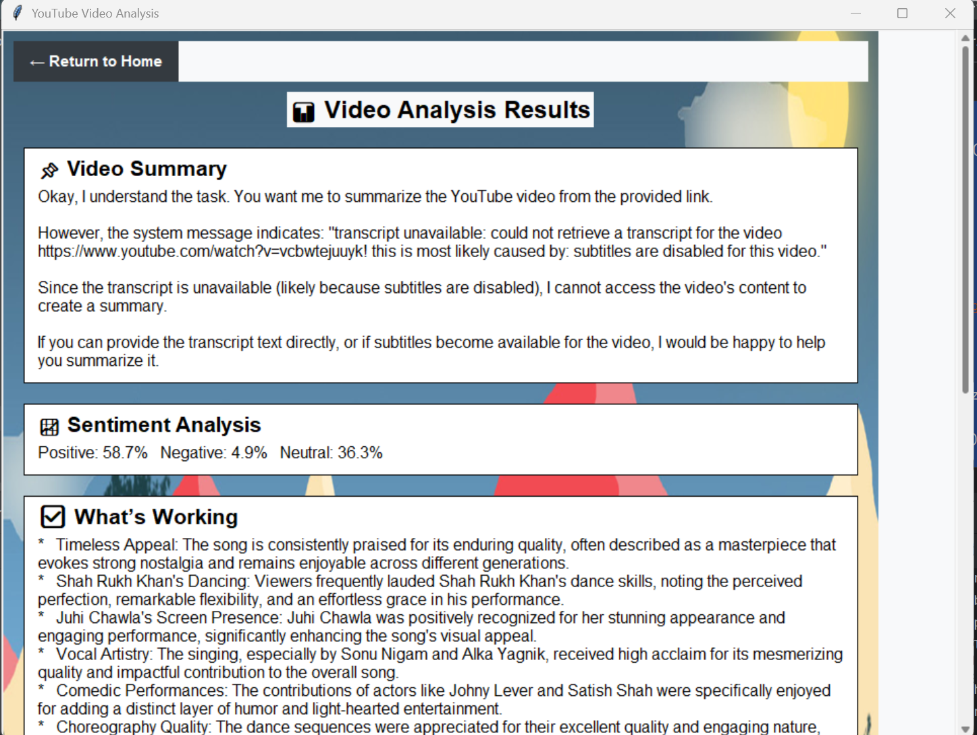
Test Case 3 Pt 1: When no transcript but comments

Slide 15
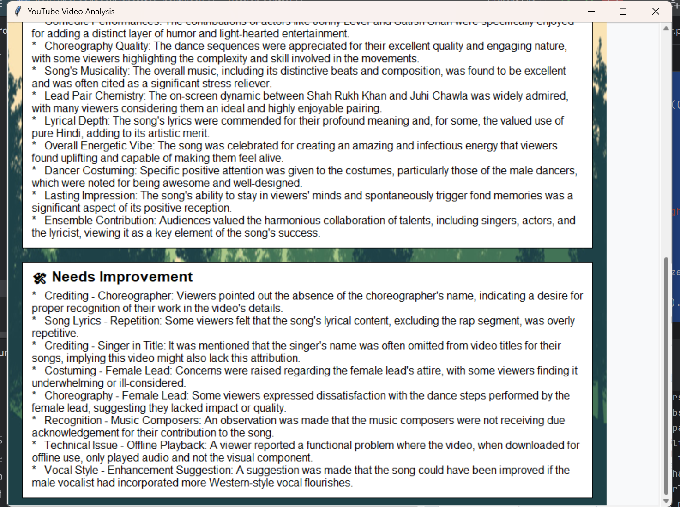
Test Case 3 Pt 2: When no transcript but comments

Slide 16
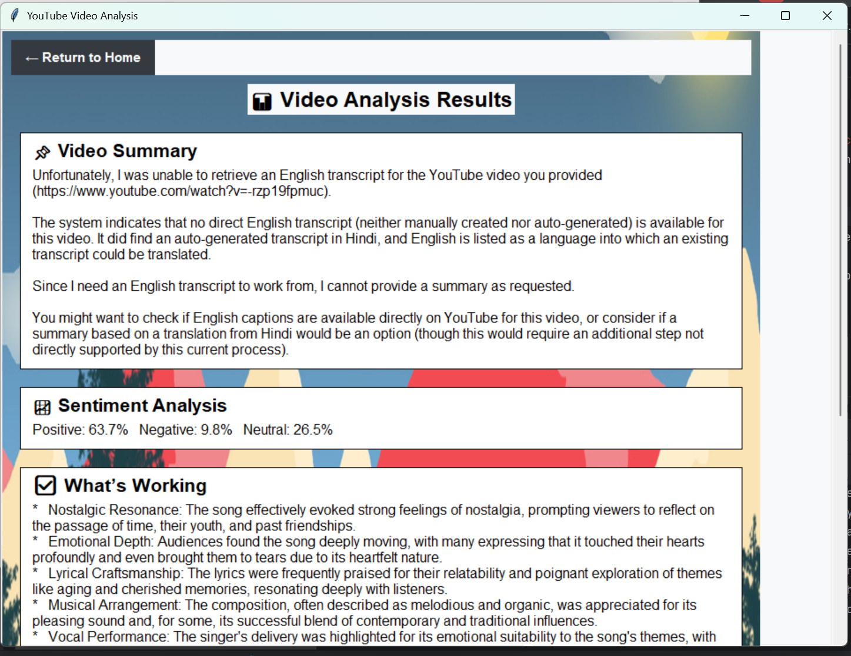
Test Case 4: When it has foreign transcript

Slide 17

Retrospective: What worked well
Prompt engineering improved accuracy and structure of AI outputs
Gemini-based bullet-point feedback displayed clearly with bolded subtopics
UI handled empty inputs, bad URLs, and API errors without crashing
Background thread + animated loading popup kept UI responsive
Feedback report saved correctly in local folder

Slide 18
Retrospective: Challenges
Regex spam filtering still misses nuanced promotional comments (data_preprocessor.py)
API keys remain hardcoded in main.py (Sprint 2 issue not resolved)
Sentiment classification slows down at ~3000 comments (batching not implemented)
Bold text workaround required due to tk.Label formatting limitations

Slide 19

Future Deliverables
Move
Move API keys to a secure configuration file to eliminate hardcoding risks
Optimize
Optimize comment processing through batching or asynchronous execution
Enhance
Enhance results UI with sentiment graphs, word clouds, and thumbnails
Transition
Transition the application from desktop (Tkinter) to a web-based interface
Improve
Improve spam filtering using smarter rule sets or lightweight ML classifiers

Slide 20















T
H
A
N
K
Y
O
U

